Slide 1




TR# 2017325

Slide 2


DIGITS
2 – DIGITS
T-Mobile confidential and proprietary information. Not for customer distribution.

Slide 3

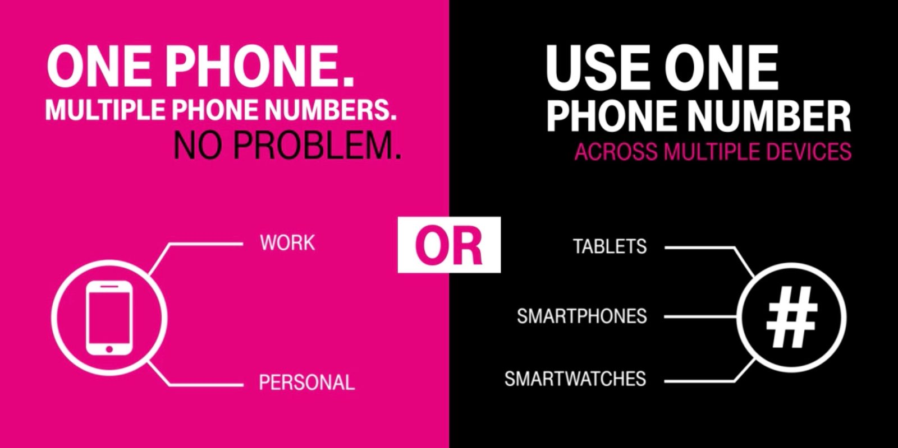
INTRO
3 – DIGITS
T-Mobile confidential and proprietary information. Not for customer distribution.

Slide 4
DO IT YOURSELF
45 MIN
LEARN DIGITS
WBT
DIGITS Video #1 (434241)
DIGITS Video #2 (434242)
DIGITS Grab & Go (434169)
DIGITS Rate Plans (438353)
DIGITS App & Web Client (428303)
Complete the following web-based training in Un-carrier Academy:
DIGITS WBT
ANSWER
MAKE IT PERSONAL
When is DIGITS free?
When does it require a rate plan?
What do the app & web client do?
How might you, personally, benefit from using DIGITS service?
Who do you know that might benefit from DIGITS?
How would you explain the service to them?
4 – DIGITS
T-Mobile confidential and proprietary information. Not for customer distribution.

Slide 5

The Download
What are the 2 main things you can do with DIGITS?
What do you need to do on devices without built-in DIGITS?
Name some devices with DIGITS built-in.
What are the 4 types of DIGITS rate plans?
5 - DIGITS
T-Mobile confidential and proprietary information. Not for customer distribution.

Slide 6
BRING IT TOGETHER
35 MIN
DIGITS Customer Creation
You will have 15 minutes to create two DIGITS customers.
One uses the free DIGITS service.
One will use a DIGITS rate plan (assigned by facilitator).
Create your DIGITS customers.
How do they use the service?
What phone and/or devices do they have?
Did they need to download the app?
What is the monthly cost of their DIGITS rate plan?
Choose a team representative.
Present your customers to the class.
6 – DIGITS
T-Mobile confidential and proprietary information. Not for customer distribution.

Slide 7
The Download
What went well?
What was challenging?
Any ‘a-ha’ moments?
What questions do you have?
7 – DIGITS
T-Mobile confidential and proprietary information. Not for customer distribution.

